Slide 1
MIDTERM REVIEW
Ivayla Nekezova

Slide 2
Table of Contents
01
Company Introduction
04
Challenges and Solutions
02
Assignment Overview
05
Next Steps
03
Planning and Structure

Slide 3
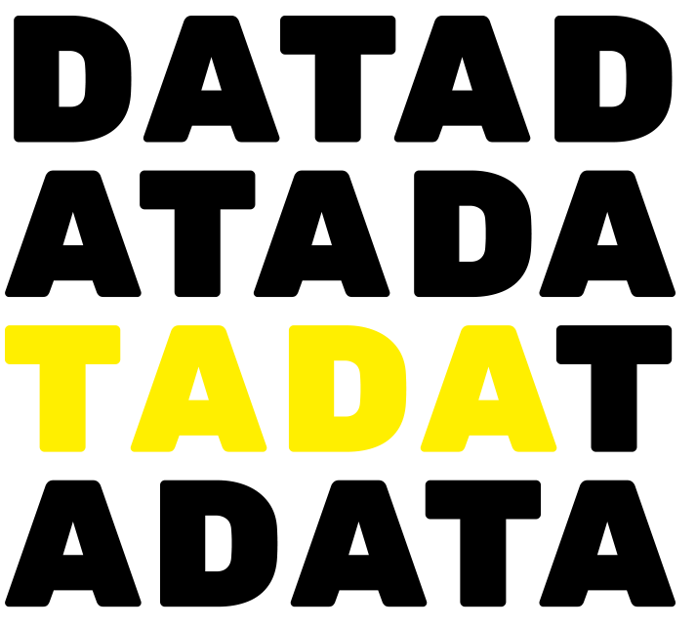
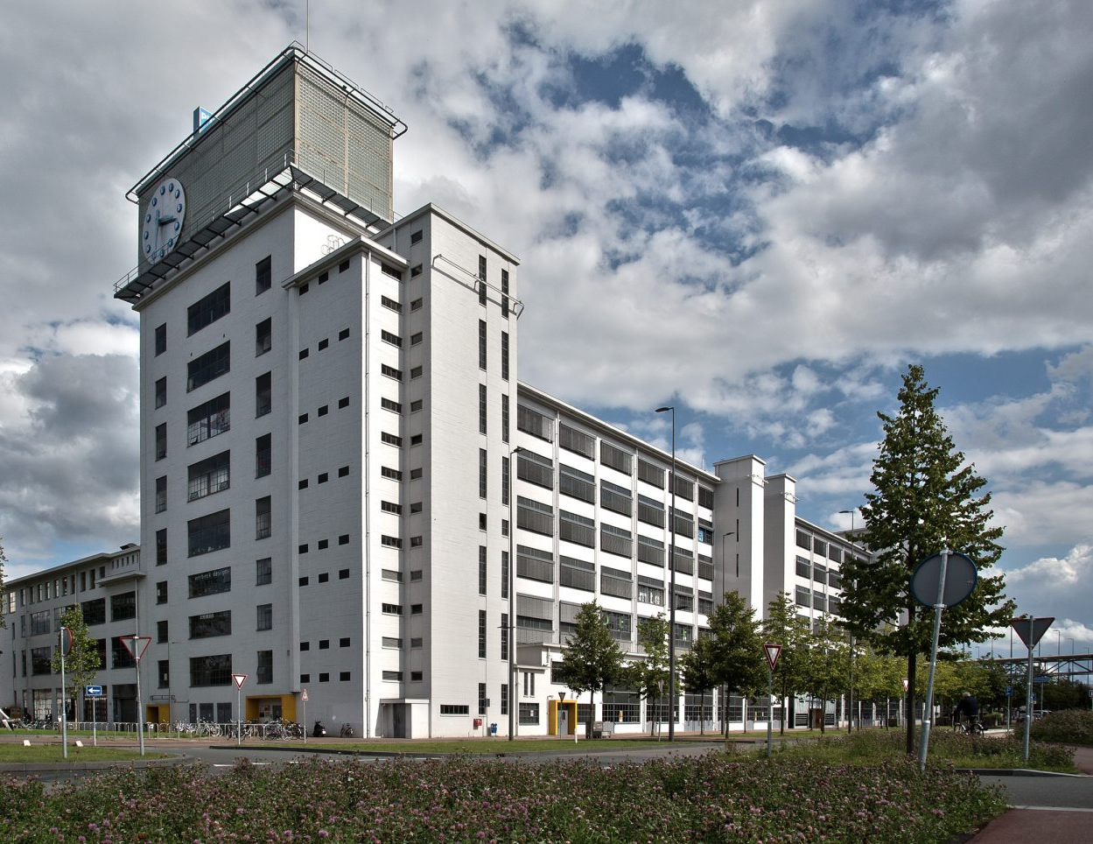
01
Company Introduction
Tada Solutions is data organisation company that:
Specialises in data management and analytics
Converts raw data into actionable insights
Creates user-friendly data dashboards in PowerBI
Focuses on enhancing data accessibility and user engagement for their clients

Slide 4
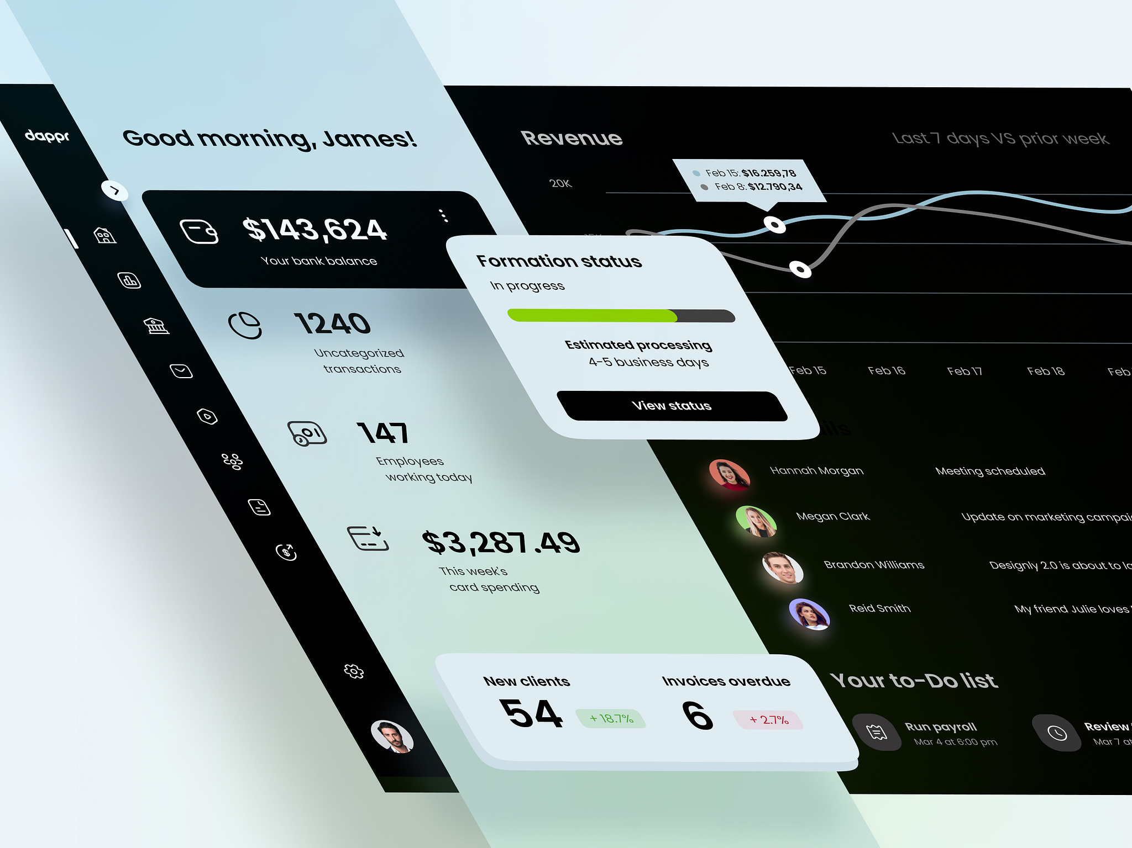
02
Assignment Overview
The project aims to enhance clients' understanding of data and its flow across company departments by creating improved data visualisation dashboards.
Notes:
This enhancement will enable clients to make more informed decisions regarding their company and business processes, fostering their growth.

Slide 5
Planning and Structure
03
Plan Phase
Design Phase
Test Phase
February 19 - March 8
March 25 - April 12
May 6 - May 24th
Successfully organised my project timeline and objectives.
Created wireframes to outline the layout and structure of the data visualisation dashboards.
Research Phase
Evaluate Phase
March 11 - March 22
May 27 - June 18
Conducted research into user needs, market trends, and best practices in data visualisation.
Develop Phase
April 15 - May 3
Notes:
For the project I choose to work with the Waterfall methodology where each phase has a main milestone which is mandatory to be completed so the next can begin. I divided my work into 6 phases:

Slide 6
Challenges Solutions
04
Scope creep
Regularly revisit project objective and prioritise features to control scope changes.
Having too many ideas and adding a lot of features is causing delays and loss of focus.
Validating Design Choices
Conduct more user testing and research to ensure alignment with user needs and project objectives.
Ensuring that design choices effectively meet user needs and project objectives.

Slide 7
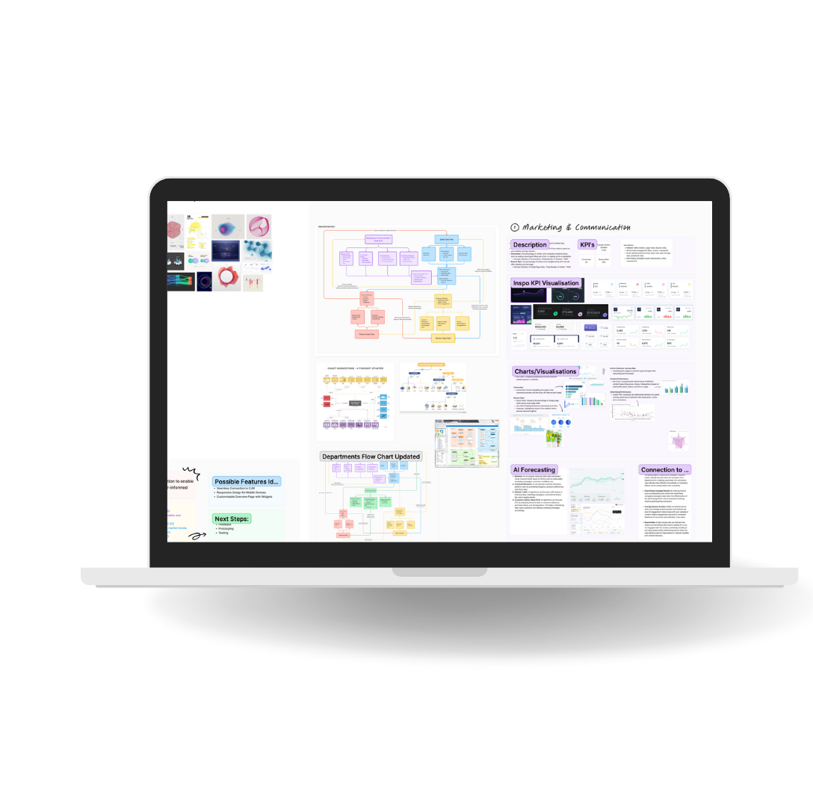
Next Steps
05
Prioritise Features
Iterate on Design
User Testing
Develop High-Fidelity Prototype
Refine
Notes:
Prioritize Features: Prioritize features based on user needs and project objectives to ensure the most important functionalities are implemented first.
Iterate on Design: Refine and iterate on the design based on user feedback and emerging insights.
User Testing: Conduct user testing to gather feedback on the design and usability of the prototypes.
Develop High-Fidelity Prototype: Create a high-fidelity prototype incorporating user feedback and design iterations.
Refine: Further refine the prototype based on user testing results and feedback, ensuring alignment with user expectations and project goals.

Slide 8

Thank you for your attention!

